Slide 1

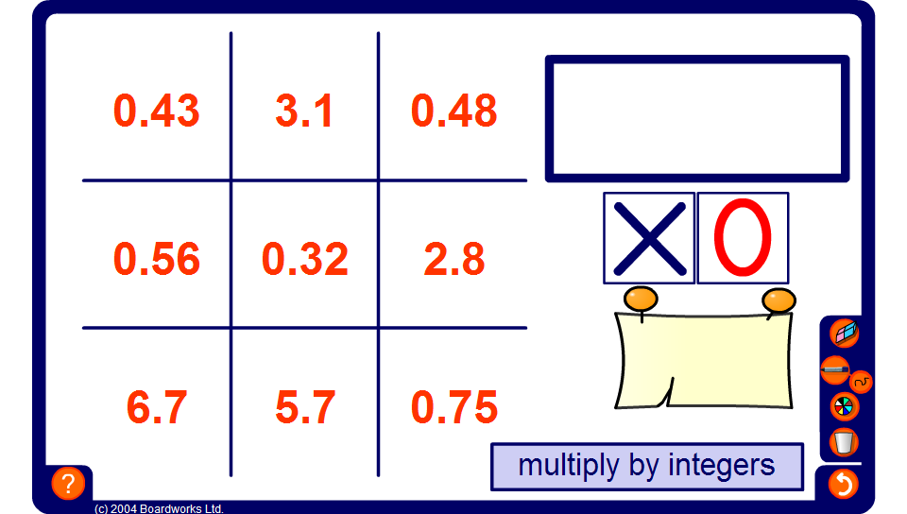


Noughts and crosses 1
Notes:
Make sure that activity is set to multiply and divide by whole numbers.
Divide the class into two teams, noughts and crosses. Decide which team will start.
The starting team chooses a number from the board. Click on the number to highlight it.
The box will randomly show an operation to be preformed on that number.
Select a pupil from the team to give you his answer.
Check their answer by clicking on the show answer button.
If the answer is correct, select that team’s symbol (a nought or a cross). If the answer is incorrect select the opposing team’s symbol.
It is then the turn of the opposing team to choose a number from the grid.
The game is over when one of the teams gets three of their symbols in a row, horizontally, vertically, or diagonally. (Or when the board is full, in which case, the game ends in a draw).

